Slide 1
1
Introduction to Computers and C
Objectives
In this chapter, you’ll:
Learn about exciting recent developments in computing.
Learn computer hardware, software and Internet basics.
Understand the data hierarchy from bits to databases.
Understand the different types of programming languages.
Understand the strengths of C and other leading programming languages.
Be introduced to the C standard library of reusable functions that help you avoid “reinventing the wheel.”
Test-drive a C program that you compile with one or more of the popular C compilers we used to develop the book’s hundreds of C code examples, exercises and projects (EEPs).
Be introduced to big data and data science.
Be introduced to artificial intelligence—a key intersection of computer science and data science.

Slide 2
1.1 Introduction
C language is one of the world’s most senior computer programming languages.
According to the Tiobe Index, the world’s most popular.
You’re probably familiar with many of the powerful task's computers perform.
In this course, you’ll get intensive, hands-on experience writing C instructions that command computers to perform those and other tasks.
Software (that is, the C instructions you write, which are also called code) controls hardware (that is, computers and related devices).

Slide 3
1.1 Introduction
C is widely used in industry for a wide range of tasks.
Today’s popular desktop operating systems—Windows, macOS and Linux—are partially written in C.
Many popular applications are partially written in C, including popular web browsers
(e.g., Google Chrome6 and Mozilla Firefox7)
Database Management Systems (e.g., Microsoft SQL Server, Oracle and MySQL) and more.

Slide 4
1.1 Introduction
We’ll discuss the types of programming languages and Introduce the C-based various “open-source” libraries. You’ll use these libraries to perform powerful tasks.
We’ll introduce additional software technologies that you’re likely to use as you develop software in your career.
Many development environments are available in which you can compile, build and run C applications.
Microsoft Visual Studio for Windows.
Clang in Xcode on macOS.
GNU gcc in a shell running inside the GNU Compiler Collection (GCC) Docker container.

Slide 5
1.1 Introduction
In the past, most computer applications ran on “standalone” computers.
Today’s applications can communicate among the world’s computers via the Internet, the World Wide Web, the Cloud and the Internet of Things (IoT), each of which could play a significant part in the applications you’ll build in the 2020s (and probably long afterward).

Slide 6
1.2 Hardware and Software
Computers can perform calculations and make logical decisions phenomenally faster than human beings can.
Today’s personal computers and smartphones can perform billions of calculations in one second—more than a human can perform in a lifetime.
Supercomputers already perform thousands of trillions (quadrillions) of instructions per second!
As of December 2020, Fujitsu’s Fugaku11 is the world’s fastest supercomputer— it can perform 442 quadrillion calculations per second (442 petaflops)!

Slide 7
1.2 Hardware and Software
Computers process data under the control of sequences of instructions called computer programs (or simply programs).
These programs guide the computer through ordered actions specified by people called computer programmers.

Slide 8
1.2.1 Moore’s Law
For decades, every couple of years, computer processing power approximately doubled inexpensively. This remarkable trend often is called Moore’s Law, named for Gordon Moore, co-founder of Intel and the person who identified this trend in the 1960s.
Intel is a leading manufacturer of the processors in today’s computers and embedded systems, such as smart home appliances, home security systems, robots, intelligent traffic intersections and more.
Similar growth has occurred in the communications field. Costs have plummeted as enormous demand for communications bandwidth (that is, information-carrying capacity) has attracted intense competition. Such phenomenal improvement is truly fostering the Information Revolution.

Slide 9
1.2.2 Computer Organization
Regardless of physical differences, computers can be envisioned as divided into various
logical units or sections.
Input Unit
Output Unit
Memory Unit
Arithmetic and Logic Unit (ALU)
Central Processing Unit (CPU)
Secondary Storage Unit

Slide 10
1.3 Data Hierarchy

Slide 11
1.4 Machine Languages, Assembly Languages and High-Level Languages
Machine languages.
Assembly languages.
High-level languages.
Compilers
Interpreters

Slide 12
1.5 Operating Systems
Windows—A Proprietary Operating System
Linux—An Open-Source Operating System
Apple’s macOS and Apple’s iOS for iPhone® and iPad® Devices
Google’s Android

Slide 13
1.6 C Programming Language
C evolved from two earlier languages, BCPL26 and B27. BCPL was developed in 1967 by Martin Richards as a language for writing operating systems and compilers. Ken Thompson modeled many features in his B language after their counterparts in BCPL, and in 1970 he used B to create early versions of the UNIX operating system at Bell Laboratories.
The C language was evolved from B by Dennis Ritchie at Bell Laboratories and was originally implemented in 1972. C initially became widely known as the development language of the UNIX operating system. Many of today’s leading operating systems are written in C and/or C++. C is mostly hardware-independent—with careful design, it’s possible to write C programs that are portable to most computers.

Slide 14
1.6 C Programming Language
Built for Performance
Operating systems
Embedded systems
Real-time systems
Communications systems
Standardization
American National Standards Institute (ANSI)
International Standards Organization (ISO)
The C11 and C18 Standards

Slide 15
1.7 C Standard Library and Open-Source Libraries
C programs consist of pieces called functions. You can program all the functions you need to form a C program. However, most C programmers take advantage of the rich collection of existing functions in the C standard library.

Slide 16
1.8 Other Popular Programming Languages
Basic
C++
Python
Java
C#
JavaScript
Swift

Slide 17
1.9 Typical C Program-Development Environment
C systems generally consist of several parts: a program-development environment, the language and the C standard library. The following discussion explains the typical C development environment.
C programs typically go through six phases to be executed—edit, preprocess, compile, link, load and execute.

Slide 18

1.9 Typical C Program-Development Environment
1.9.1 Phase 1: Creating a Program
Phase 1 (in the following diagram) consists of editing a file in an editor program:

Slide 19
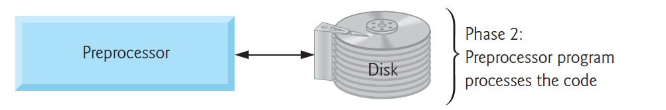
1.9 Typical C Program-Development Environment
1.9.2 Phases 2 and 3: Preprocessing and Compiling a C Program
In Phase 2 (shown in the following diagram), you give the command to compile the program:

Slide 20
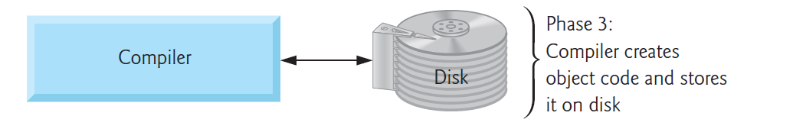
1.9 Typical C Program-Development Environment
1.9.2 Phases 2 and 3: Preprocessing and Compiling a C Program
In Phase 2 (shown in the following diagram), you give the command to compile the program:

Slide 21
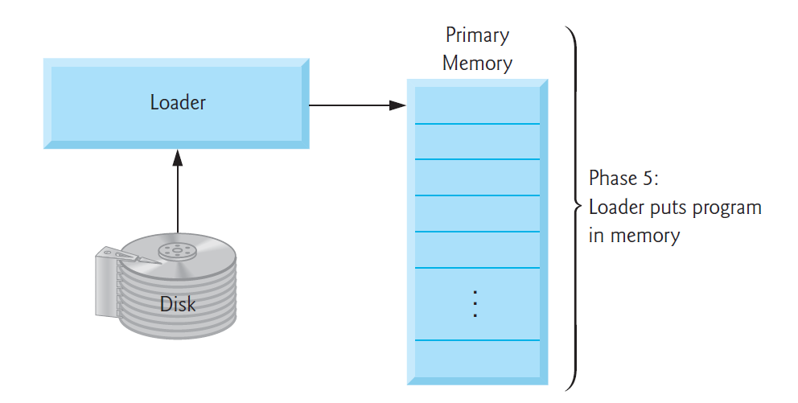
1.9 Typical C Program-Development Environment
1.9.4 Phase 5: Loading
The next phase (shown in the following diagram) is called linking:

Slide 22
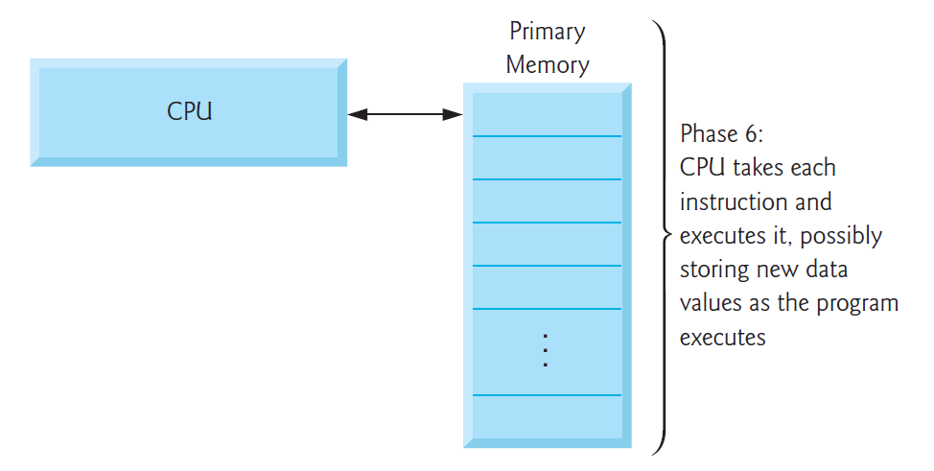
1.9 Typical C Program-Development Environment
1.9.5 Phase 6: Execution
Finally, in the last phase (shown in the following diagram), the computer, under the control of its CPU, executes the program one instruction at a time:

Slide 23
1.10 Test-Driving a C Application in Windows, Linux and macOS
Demo

